Slide 1
Course
AWS Cloud Practitioner
MaxCloud

Slide 2
09
Class
Amazon EventBridge
Amazon SNS
Amazon SQS
Amazon SES
AWS ioT Core, Greengrass

Slide 3
Amazon Eventbridge
EventBridge is a serverless service that uses events to connect application components together, making it easier for you to build scalable event-driven applications.
Event-driven architecture is a style of building loosely-coupled software systems that work together by emitting and responding to events.
Event-driven architecture can help you boost agility and build reliable, scalable applications.

Slide 4
Amazon Eventbridge
EventBridge includes two ways to process events: event buses and pipes.
Event buses are routers that receive events and delivers them to zero or more targets. Event buses are well-suited for routing events from many sources to many targets, with optional transformation of events prior to delivery to a target.
Pipes EventBridge Pipes is intended for point-to-point integrations; each pipe receives events from a single source for processing and delivery to a single target. Pipes also include support for advanced transformations and enrichment of events prior to delivery to a targe

Slide 5
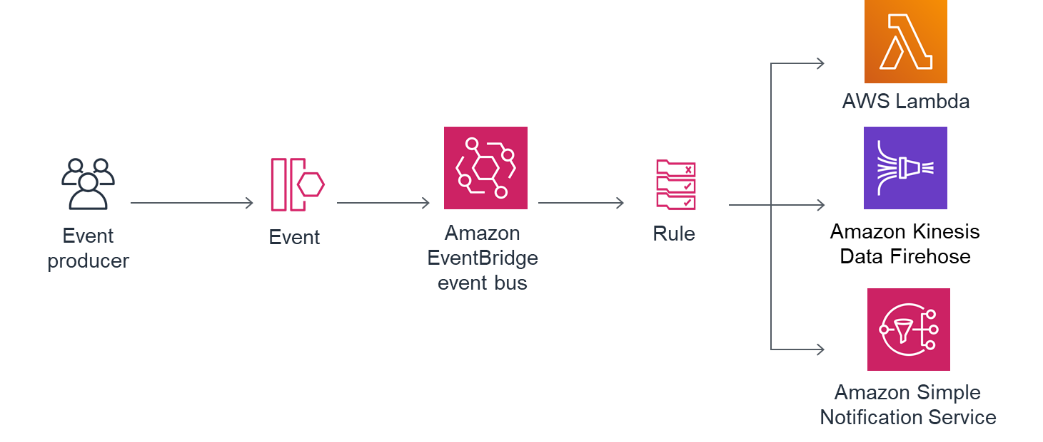
Amazon Eventbridge

Slide 6
Amazon SNS
Amazon Simple Notification Service (Amazon SNS) is a managed service that provides message delivery from publishers to subscribers (also known as producers and consumers).
Publishers communicate asynchronously with subscribers by sending messages to a topic, which is a logical access point and communication channel.
Clients can subscribe to the SNS topic and receive published messages using a supported endpoint type, such as Amazon Kinesis Data Firehose, Amazon SQS, AWS Lambda, HTTP, email, mobile push notifications, and mobile text messages (SMS).

Slide 7
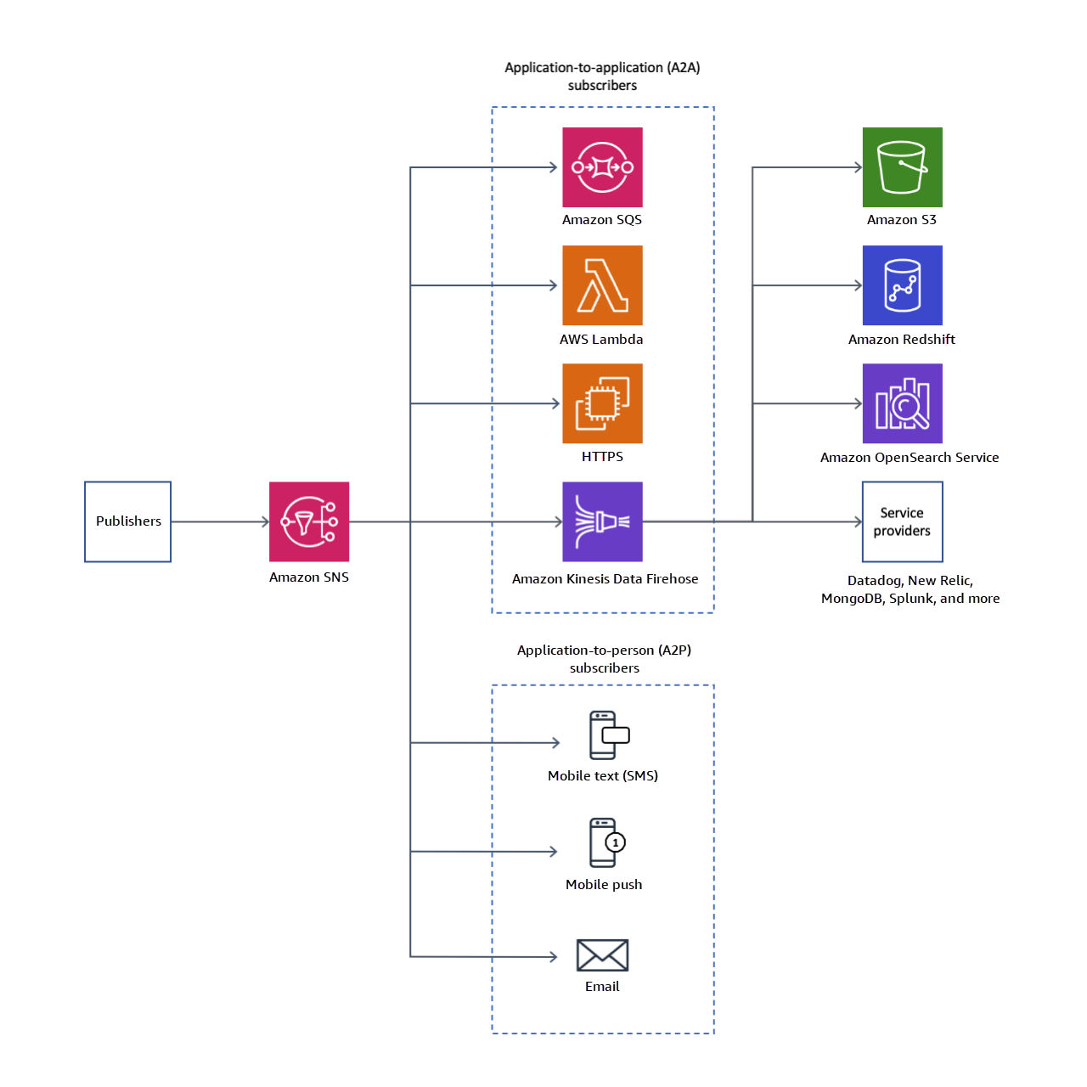
Amazon SNS

Slide 8
Amazon SQS
Amazon Simple Queue Service (Amazon SQS) offers a secure, durable, and available hosted queue that lets you integrate and decouple distributed software systems and components.
Amazon SQS offers common constructs such as dead-letter queues and cost allocation tags. It provides a generic web services API that you can access using any programming language that the AWS SDK supports.

Slide 9
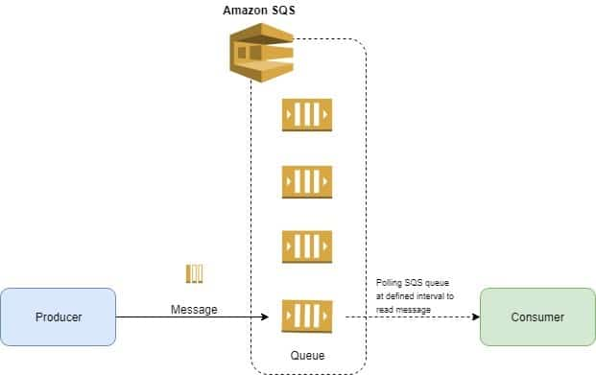
Producer - Consumer

Slide 10
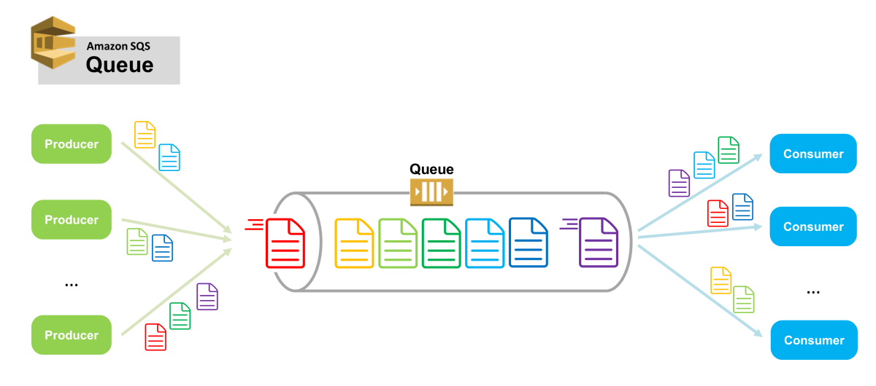
Producers - Consumers

Slide 11
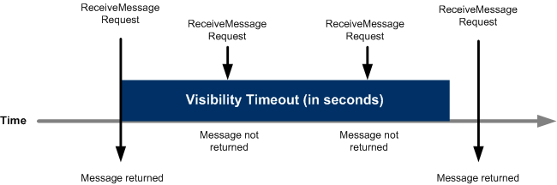
Visibility timeout

Slide 12
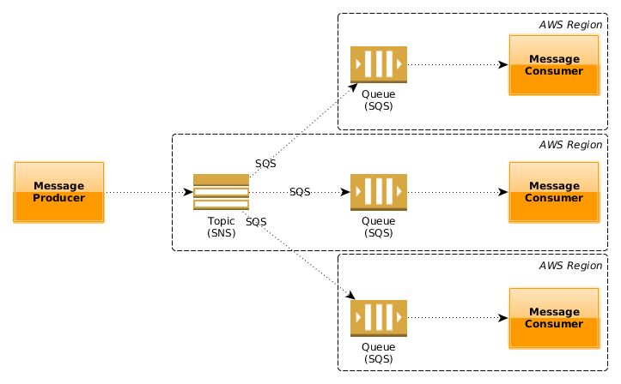
SNS + SQS => Fanout

Slide 13
Amazon SES
Amazon Simple Email Service (SES) is an email platform that provides an easy, cost-effective way for you to send and receive email using your own email addresses and domains.
For example, you can send marketing emails such as special offers, transactional emails such as order confirmations, and other types of correspondence such as newsletters. When you use Amazon SES to receive mail, you can develop software solutions such as email autoresponders, email unsubscribe systems, and applications that generate customer support tickets from incoming emails.

Slide 14
AWS IoT Core
AWS IoT provides the cloud services that connect your IoT devices to other devices and AWS cloud services.
AWS IoT provides device software that can help you integrate your IoT devices into AWS IoT-based solutions. If your devices can connect to AWS IoT, AWS IoT can connect them to the cloud services that AWS provides.

Slide 15
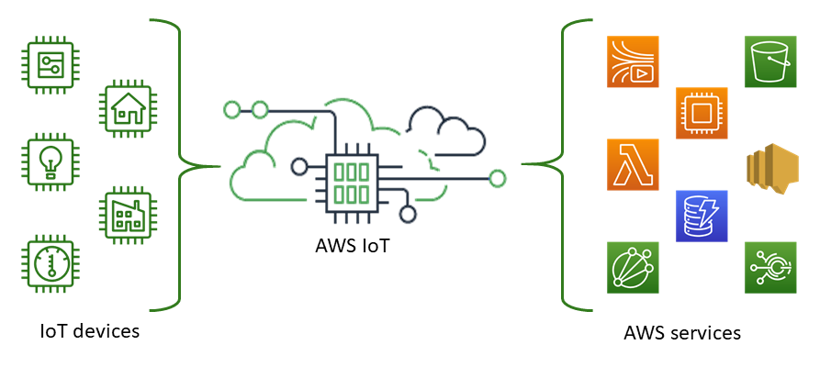
AWS IoT Core

Slide 16
AWS IoT Greengrass
AWS IoT Greengrass is an open source Internet of Things (IoT) edge runtime and cloud service that helps you build, deploy and manage IoT applications on your devices.

Slide 17
Muchas Gracias

